Slide 1
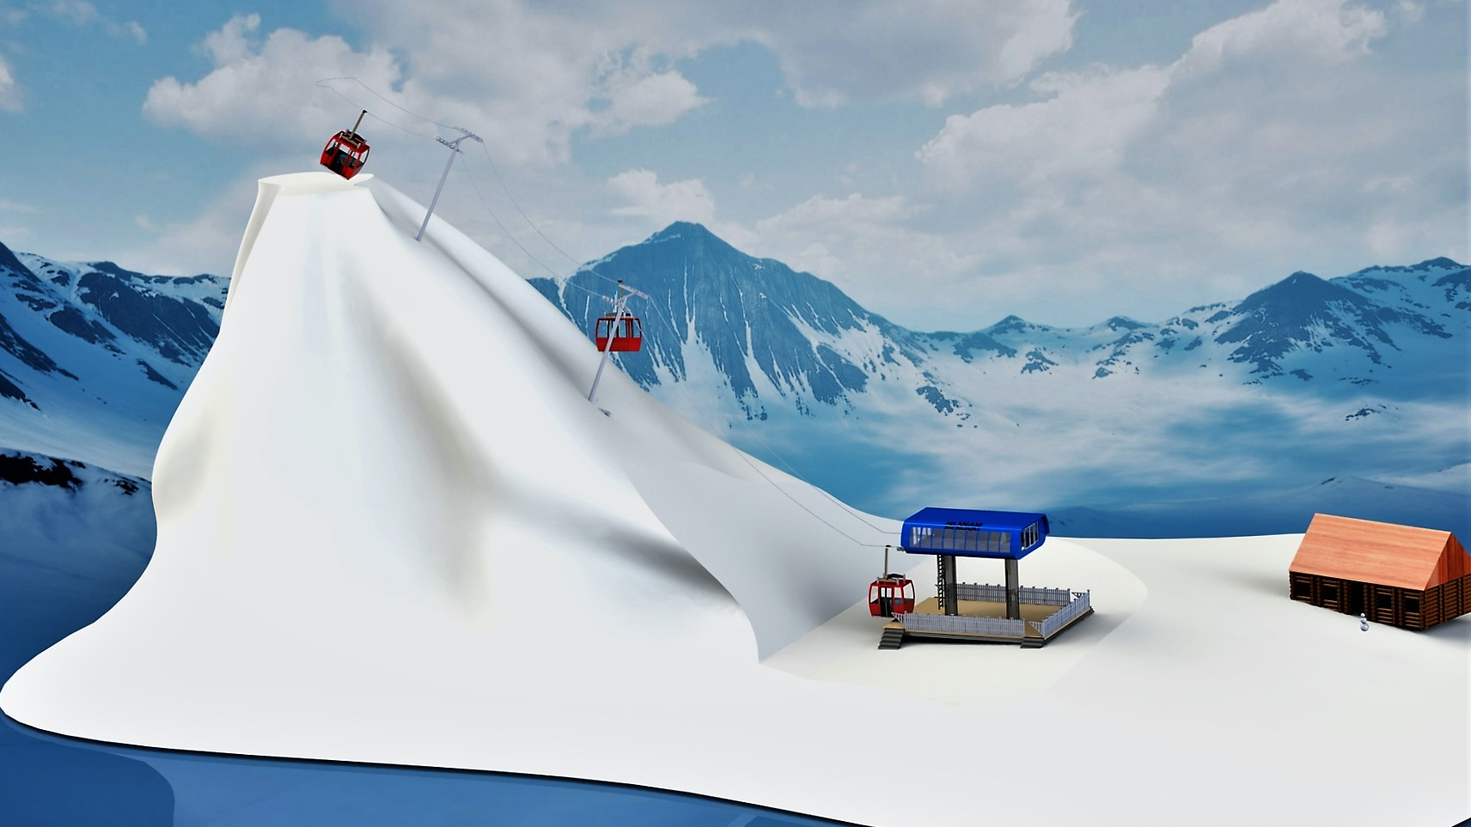

Slide 2
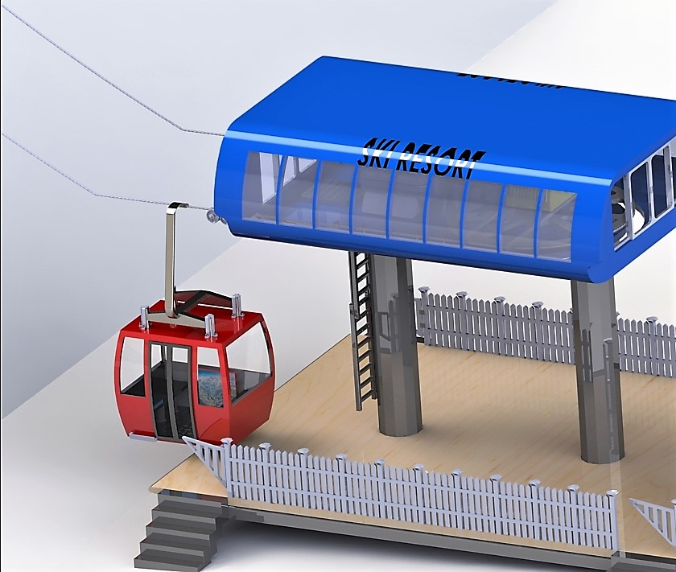
Closeup
of
the
main
parts
-Gondola
-Hub
-Platform
-Cable

Slide 3
In total we...
Designed 86 parts
Used 346 parts in total
Made 29 subassemblies
Used 43 subassemblies in total
All to make…
One great ski lift!

Slide 4
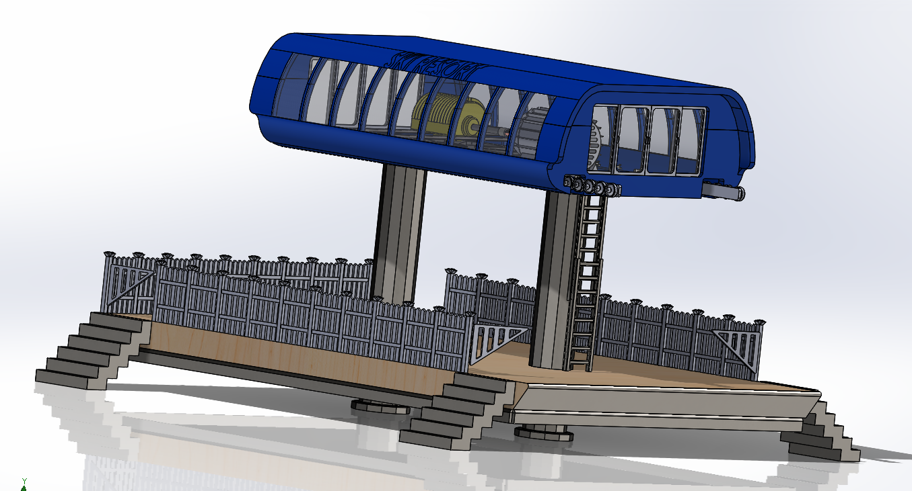
Platform that holds the hub

Slide 5
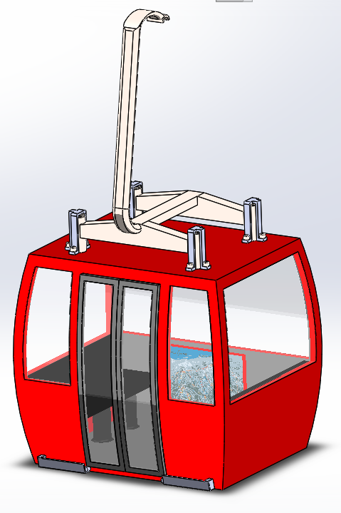
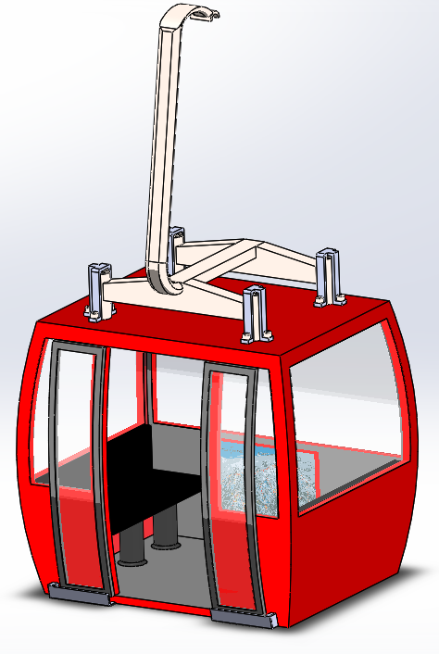
Gondola

Slide 6
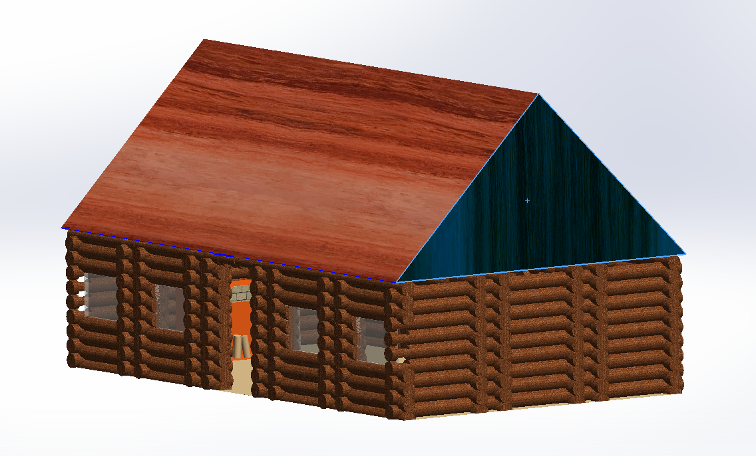
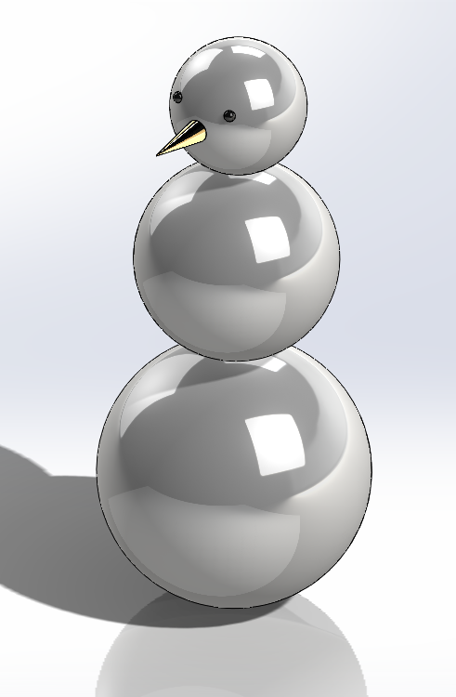
Lincoln Log cabin and snowman

Slide 7
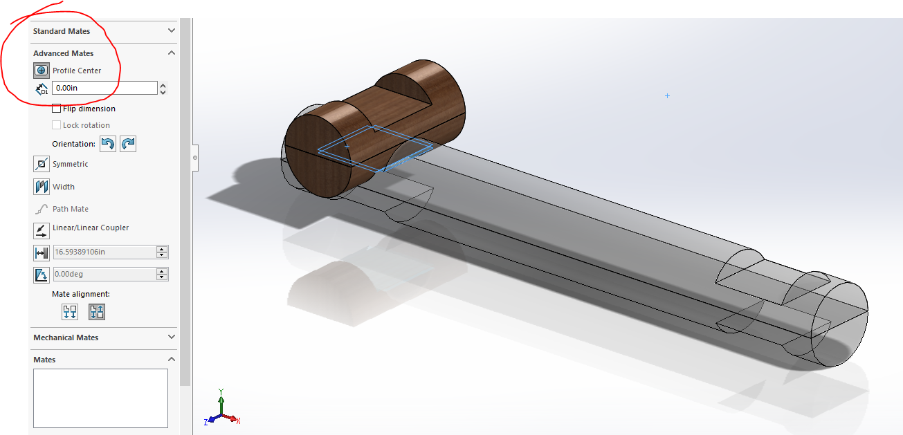
Lincoln Logs

Slide 8
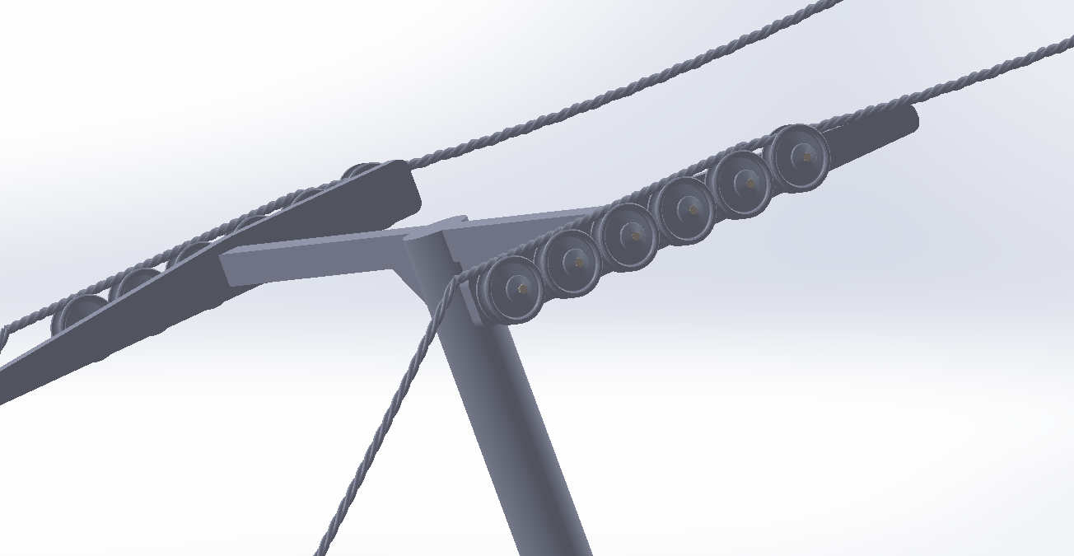
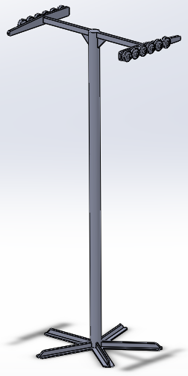
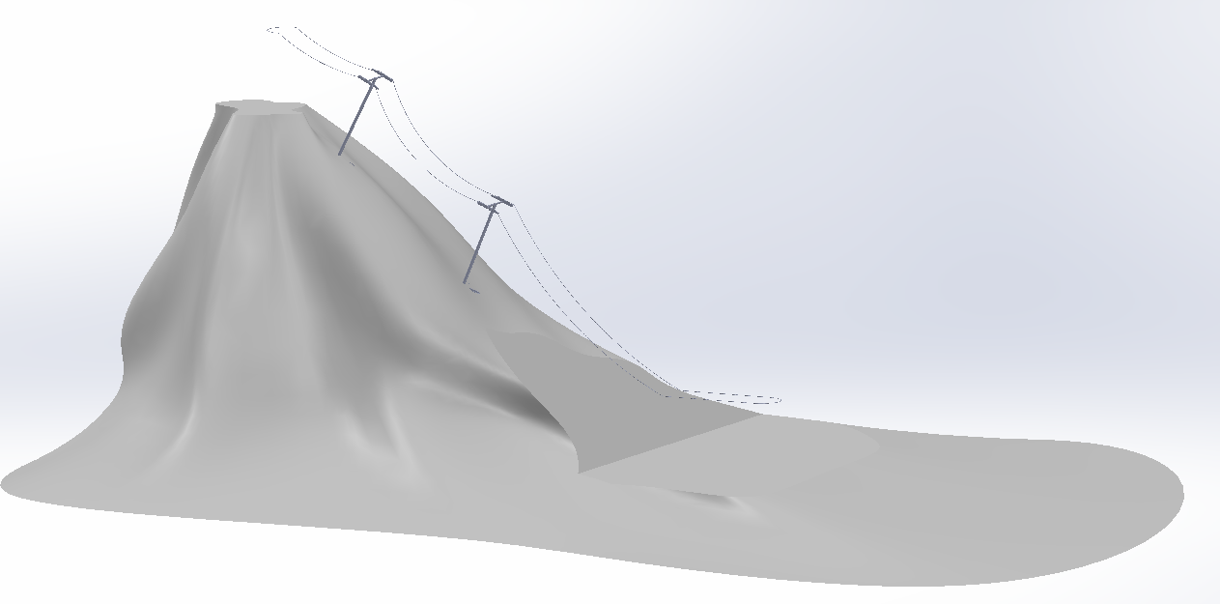
Cable, Mountain, and Towers

Slide 9
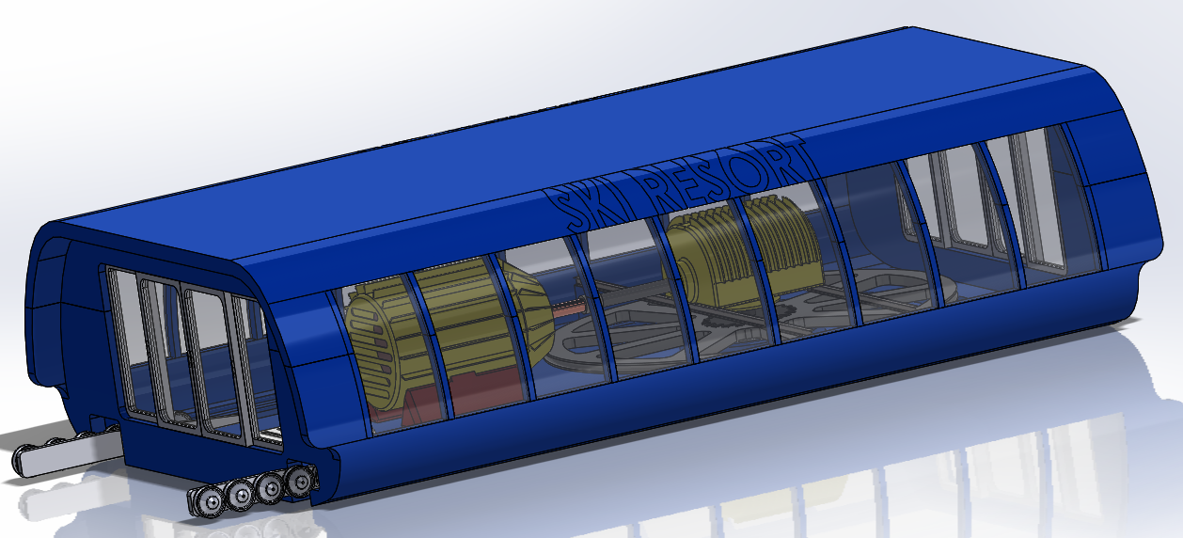
Hub

Slide 10
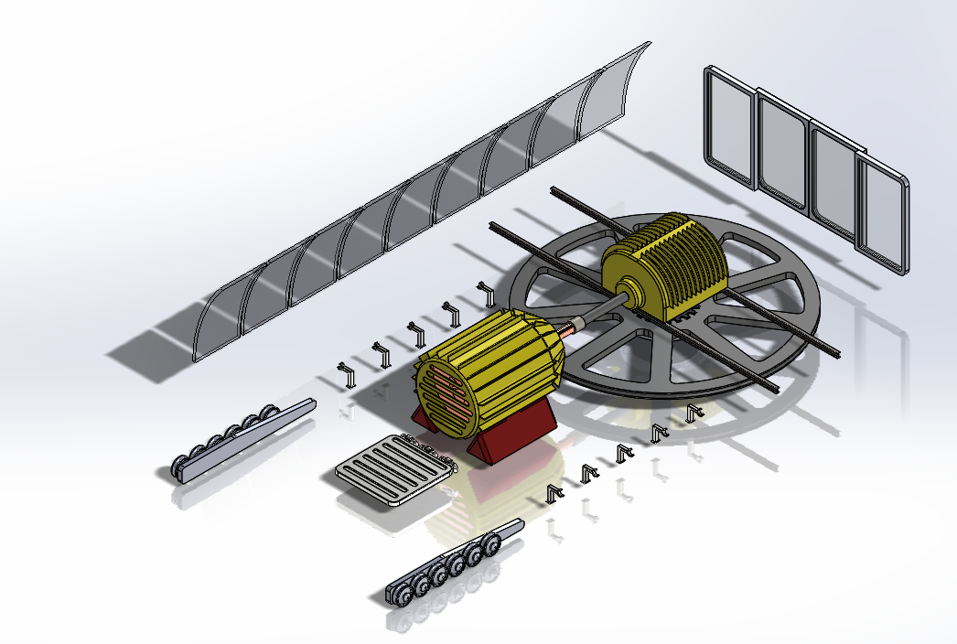
The inside of the hub

Slide 11
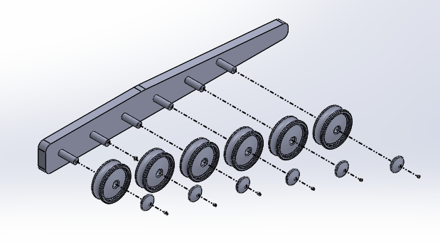
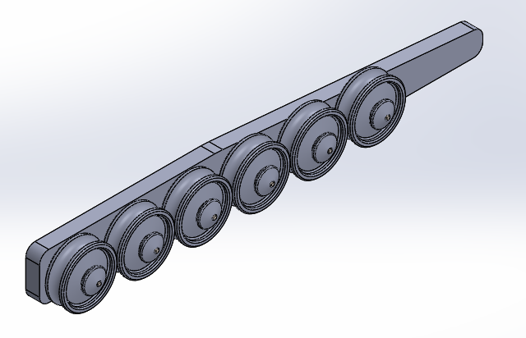
Exploded view (attach to the towers)

Slide 12
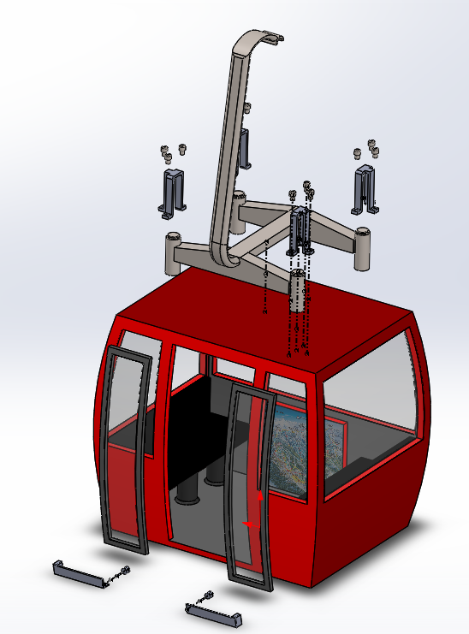
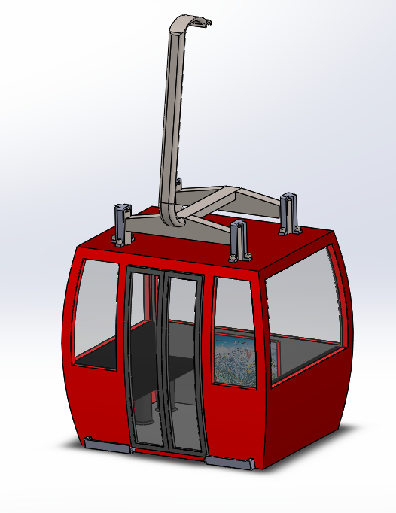
Exploded view of gondola

Slide 13
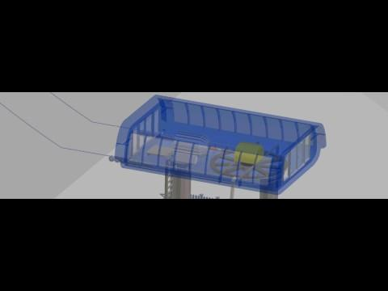
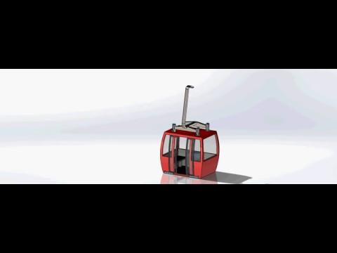
Animations

Slide 14
CONCLUSION
Challenges
Large scale project takes ages to open
Mating subassemblies along the curved contour of a mountain
Extruding a massive, intertwined cable
Increased Understanding
Better comprehension of large scale assemblies
Knowledge of new advanced mates, such as ‘center profile’
Improved skills mating subassemblies, while maintaining flexibility

